Slide 1
Chapter 3: Technologies & Promotion of culture in a Globalizing World
Related Issue: To what extent should globalization shape identity?
Chapter Issue: To what extent do media and communications technology affect identity?

Slide 2
What SOCIAL NETWORKING sites do you use?
How do you use them?
How often to you use them?

Slide 3
Social Networks
Anyone watch “The Social Network”?
Why are websites like Facebook so popular? What do we “get” out of using them so frequently?
How many hours a day would you say you spend on the computer accessing these social websites?

Slide 4
Facebook was created in 2004 by Mark Zuckerberg and is currently the number one social networking site with over 500 million users. Mark Zuckerberg created Facebook while attending Harvard and it was originally created just for Harvard students but became open to the public completely in 2006.

Slide 5
Social Networks
http://www.youtube.com/watch?v=r0h0LlCu8Ks
Does Seth Godin make a good point about online social networking?
Is it common to have real life interactions with people you only know online?
Is it more a boost of ego, or do you really feel connected to people while online or connected to an online community?

Slide 6
Twitter
https://www.youtube.com/watch?v=rIpD7hfffQo
What did you like/dislike about this video?

Slide 7
Twitter
Twitter was launched by Jack Dorsey in 2006 and it is a microblog that limits posts to 140 characters. It is important to understand how to use twitter because it not only acts as a portal for you to keep up with your friends, but it also acts as a real-time search engine covering millions of topics.

Slide 8
The Media
What are some examples of Media Transnationals?
Where do you gain access to a lot of your entertainment/news?

Slide 9
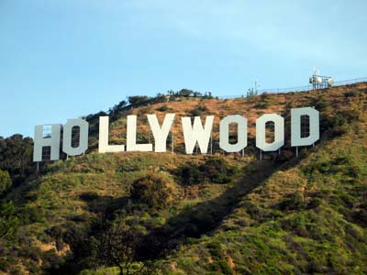
Media Transnationals
Movies, video games, MP3 downloads, magazines, theme parks…
Media Consolidations: Media companies merging into media transnationals
i.e. HBO is owned by AOL/Time Warner.

Slide 10
What are some Advantages & Disadvantages of Transnationals?

Slide 11
Advantages of Transnationals
Large $$ and human resources to create new media
Many enjoy the media created by these corporations (more advanced)
They can use their control of the media to express the voices of diverse cultures

Slide 12
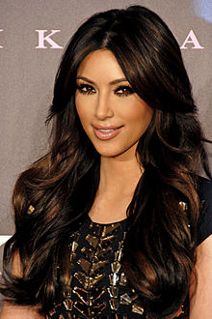
Disadvantages of Transnationals
Too much influence over world culture
Smaller media cannot compete
Transnationals sometimes do not use their power to express the voices of diverse cultures

Slide 13
Universalization of Popular Culture and Hybridization
Universalization: This means a large number of people experience much of the same culture
Hybridization: People also use media and communications technology to create hybrid cultures and identity
Mixing media and art forms i.e. different combinations of theatre, dance, and music art forms.
Mixing elements from different cultures i.e. clothing, music, spirituality.
Music vs. Visual Art

Slide 14
How do media and communications technologies affect identity?
Price of Beauty: https://www.youtube.com/watch?v=QvbHO1RtT4M
Perception of Beauty: https://www.youtube.com/watch?v=G7Zh-3C5jH4
Comfortable: https://www.youtube.com/watch?v=f0tEcxLDDd4

Slide 15
Canadian Film

Slide 16
Canadian Film
Why are Canadians not watching Canadian Films?
Does any one know any examples of some Canadian Films?
What about Canadian actors/singers?
Which Film Industry has the most influence on Canada? The world? Why do you think this is the case?

Slide 17
Canadian Broadcasting
CBC and Radio Canada
Public vs. Private Broadcasters
CBC: Canadian Broadcasting Corp. (“Canadian Culture”)
SRC: Societe Radio-Canada (Francaphone Culture)
Both of these corporations use radio, the internet and television to express Canadian perspectives

Slide 18
Canadian Film
Why aren’t Canadians watching?
Some say that we prefer American films…
Some say that we are overly-influenced by the impact of the media trans-nationals
Most Canadian Films are independent and do not receive the $ needed for advertising.

Slide 19
Diverse Cultures Use Communications Technology
APTN: Aboriginal Peoples Television Network
APTN reflects aboriginal cultures, languages and communities of diverse aboriginal peoples across Canada.
Launched in September 1999
Programming for, about and by Aboriginal people

Slide 20
Strategies for Promoting Bilingualism
Set out goals in a founding document
Do what is in your immediate power
Investigate problems as they emerge
Follow up with a report
Take immediate action
Reconfirm your goals
Use encouragement
Legislate change!

Slide 21
CRTC: Successful Promoter of Culture?
CRTC: Canadian Radio-television and Telecommunication Commission
The CRTC set the amount of Canadian content (CanCon) that we see on Television
Pro: Gives Canadian Artists exposure
Con: Prevents Canadians from choosing what they want to see.

Slide 22
INVESTIGATION: Minority Languages
Read pages 64-65
Answer questions 1 and 2

